Slide 1

ETL Project:
US Aquaculture
Imports and Exports
Group 3: Andrew Anastasiades, Tianyue Yang, Caroline Larry, Niraj Khatri, Diana Kennen

Slide 2
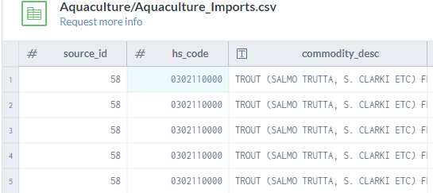
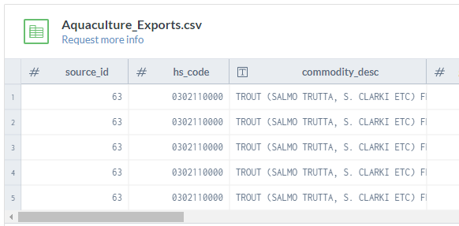
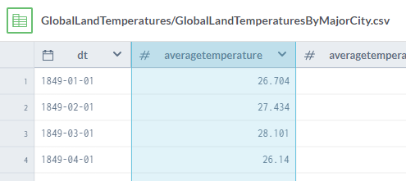
Data Source Extraction
US Aquaculture Imports
Dept of Agriculture
1989-2016
548k Rows
US Aquaculture Exports
Dept of Agriculture
1989-2016
368k Rows
Global Climate Change
Data from
1750－2015

Slide 3
Transformation
Cleaning
Joining
Drop source ID from Commercial, Drop temp uncertainty, city, latitude, longitude, day from temp table
Concatenation of Imports and Exports
Categorize commodities in fish type as within 8 basic types (ie. trout, salmon)
Split attribute description into US Import/Export and Quantity or Value
Renaming countries for compatibility across df
Consolidating East and West Germany data
Filtering
Aggregating
GroupBy: Country, Fish Type, Measure, Direction
Group temp data by country, year, month
Countries for compatibility with temperature df
Fixing problem with HS Code and duplicate keys

Slide 4
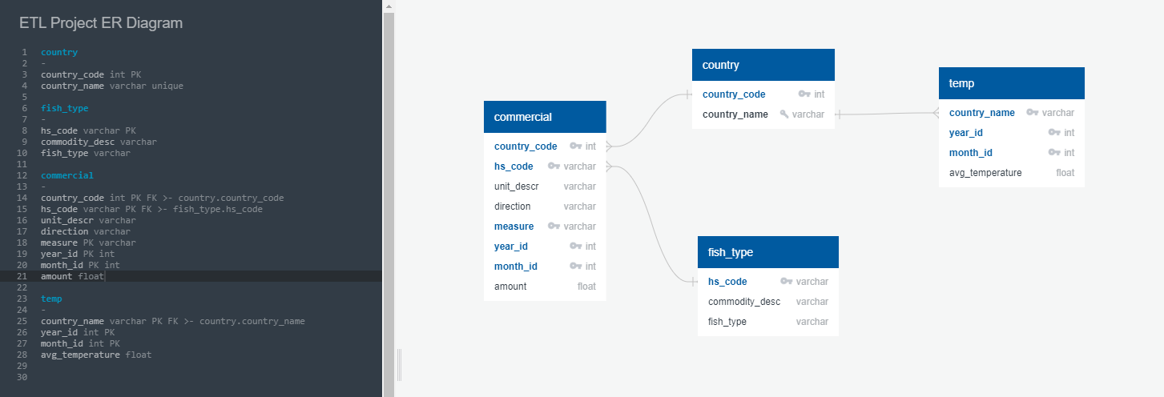
Loading: ERD

Slide 5
Loading: SQL Database
ERD Schema (Tables)
Commercial
Country
Export Data from Python
csv
Import
csv to
SQL Tables
Sample SQL
Queries
Temp
Fish Type
A New Round of Cleaning

Slide 6
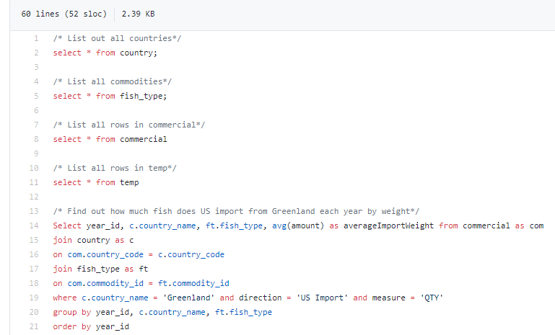
Sample Queries

